Slide 1
CSC 236
Tutorial Number 7 - Daniel Razavi

Slide 2
Did you guys like the whole competition tutorial?

Slide 3
Quick Survey
Please write your answers anonymously on a piece of paper.

Slide 4
What do you think the graders should keep doing?
What the graders should start doing?
What the graders should stop doing?

Slide 5
Today’s Problem Set

Slide 6
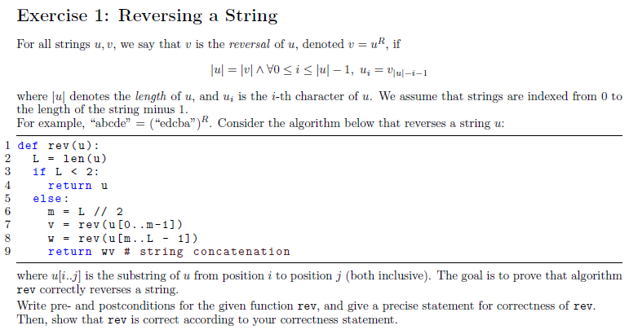

Slide 8
Precondition u is a string.
Postcondition returns reversal of u.

Slide 9
Precondition u is a string.
Postcondition returns reversal of u.
Path 1: a list of length 0 or 1. In each case, the reversal of such a list is the list itself, so returning u here is correct behaviour.

Slide 10
Precondition u is a string.
Postcondition returns reversal of u.
Path 1: a list of length 0 or 1. In each case, the reversal of such a list is the list itself, so returning u here is correct behaviour.
Path 2: here we have a list of length at least 2.
m is an integer with 1 <= m <= L-1.
The v recursive call excludes at least u[L-1] and the w recursive call excludes at least u[0], so each call is on a smaller list.
In addition, the preconditions hold, because substrings of strings are strings.

Slide 11
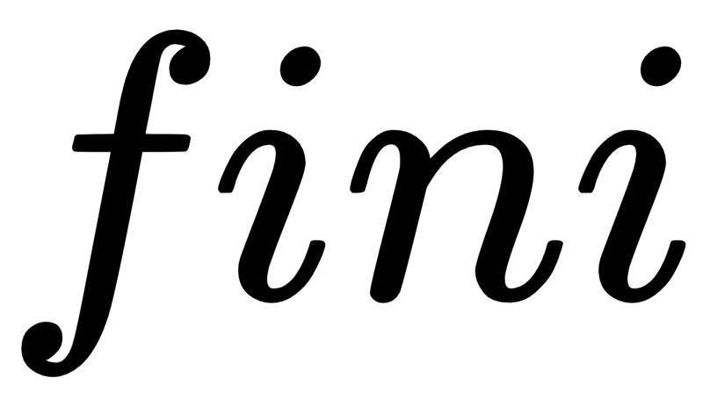
Precondition u is a string.
Postcondition returns reversal of u.
Path 1: a list of length 0 or 1. In each case, the reversal of such a list is the list itself, so returning u here is correct behaviour.
Path 2: here we have a list of length at least 2.
m is an integer with 1 <= m <= L-1.
The v recursive call excludes at least u[L-1] and the w recursive call excludes at least u[0], so each call is on a smaller list.
In addition, the preconditions hold, because substrings of strings are strings.
Now we know that v is the reversal of u[0..m-1] and w is the reversal of u[m..L-1].
We then use the identity (this can be proved separately):
(uv)^R = v^R u^R
to conclude that the correct value is returned.

Slide 12
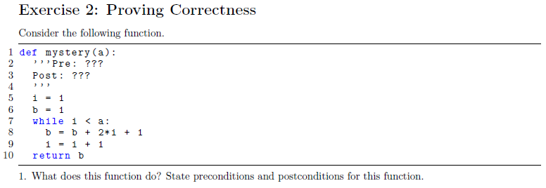

Slide 13
The precondition is that a is an integer >= 1.
The postcondition is that the function returns a^2, the square of a.

Slide 14
The precondition is that a is an integer >= 1.
The postcondition is that the function returns a^2, the square of a.
Prior to the loop starting, we have i=1 and b=1.
Substituting into the invariant, we must prove:
1 <= 1 <= a and 1 = 1 ²
The only thing to prove here is 1 <= a, which holds by the precondition.

Slide 15
The precondition is that a is an integer >= 1.
The postcondition is that the function returns a^2, the square of a.
Prior to the loop starting, we have i=1 and b=1.
Substituting into the invariant, we must prove:
1 <= 1 <= a and 1 = 1 ²
The only thing to prove here is 1 <= a, which holds by the precondition.
Now suppose that the invariant holds at the beginning of some arbitrary loop iteration:
1 <= i₀ <= a and b₀= i₀ ²
We must prove that it holds at the end of that iteration:
1 <= i₁ <= a and b₁ = i₁²

Slide 16
The precondition is that a is an integer >= 1.
The postcondition is that the function returns a^2, the square of a.
Prior to the loop starting, we have i=1 and b=1.
Substituting into the invariant, we must prove:
1 <= 1 <= a and 1 = 1 ²
The only thing to prove here is 1 <= a, which holds by the precondition.
By the loop body, we have i₁ = i₀+1 and b₁ = b₀+2*i₀+1.
We also have, by the loop-condition, that i₀ < a. We take each of the 3 pieces of the invariant in turn:
1. Prove 1 <= i₁, or 1 <= i₀+1. This holds as 1 <= i₀ (by invariant) <= i₀+1.
2. Prove i₁ <= a, or i₀+1 <= a. By the loop-condition, we have i₀ < a, so i₀+1 <= a.
3. Prove b₁ = i₁²...
Now suppose that the invariant holds at the beginning of some arbitrary loop iteration:
1 <= i₀ <= a and b₀= i₀ ²
We must prove that it holds at the end of that iteration:
1 <= i₁ <= a and b₁ = i₁²

Slide 17
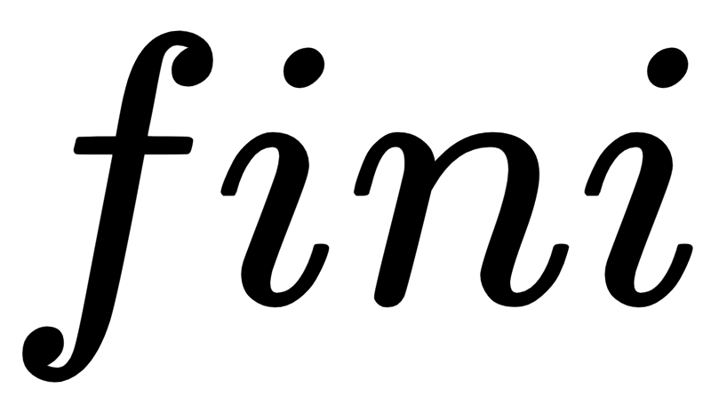
The precondition is that a is an integer >= 1.
The postcondition is that the function returns a^2, the square of a.
3. Prove b₁ = i₁²:
We have:
b₁ = b₀+2*i₀+1 (by loop body)
= i₀²+2*i₀+1 (by invariant)
= (i₀+1)²
= i₁² (by loop body)
Now we know that if the loop terminates, we have:
1 <= i <= a and b = i² and i >= a
or
i = a and b = i²
or
b = a²
So, returning b is correct.
Prior to the loop starting, we have i=1 and b=1.
Substituting into the invariant, we must prove:
1 <= 1 <= a and 1 = 1 ²
The only thing to prove here is 1 <= a, which holds by the precondition.
Now suppose that the invariant holds at the beginning of some arbitrary loop iteration:
1 <= i₀ <= a and b₀= i₀ ²
We must prove that it holds at the end of that iteration:
1 <= i₁ <= a and b₁ = i₁²
By the loop body, we have i₁ = i₀+1 and b₁ = b₀+2*i₀+1.
We also have, by the loop-condition, that i₀ < a. We take each of the 3 pieces of the invariant in turn:
1. Prove 1 <= i₁, or 1 <= i₀+1. This holds as 1 <= i₀ (by invariant) <= i₀+1.
2. Prove i₁ <= a, or i₀+1 <= a. By the loop-condition, we have i₀ < a, so i₀+1 <= a.

Slide 18
CSC 236
Tutorial Number 7 - Daniel Razavi

